Slide 1
Topic:A personalized travel and tracking app
TEAM MEMBERS:SARATHI.M
PUGAZHENDHI.S
SHEIK VASEER.S

Slide 2
Description
TravelMate is an all-in-one travel and tracking app designed to make your journeys smarter, easier, and more enjoyable. Whether you're traveling for business or pleasure, our app offers a personalized experience, helping you plan, track, and discover with ease.
Key Features:
Personalized Itinerary Management: - Automatically syncs with your travel bookings (flights, hotels, tours, etc.). - Creates a customized itinerary based on your preferences, interests, and travel history. - Includes real-time updates and reminders for each leg of your trip (flight delays, gate changes, check-in times).
2. Smart Travel Assistant: - AI-powered recommendations for things to do, places to visit, and restaurants tailored to your tastes and location. - Get suggestions based on your past trips, current location, and local trends. - Voice assistant to help with quick queries, such as directions, weather updates, or local attractions.
3. Live Trip Tracking & Notifications: - Track the status of your flights, trains, buses, and other transportation modes in real-time. - Receive automatic updates on delays, cancellations, gate changes, or alternate routes. - Set up travel alerts for important events like weather changes or strikes that may impact your journey.
4. Expense & Budget Tracker: - Record your travel expenses and stay within your budget with detailed tracking
5. Interactive Maps & Navigation: - Get access to detailed, offline maps of your destinations, including points of interest, hidden gems, and suggested routes. - Real-time GPS navigation for walking, driving, or public transportation. - Augmented reality mode to explore landmarks and attractions with visual guides.

Slide 3
import android.content.Context
import android.content.Intent
import android.os.Bundle
import androidx.activity.ComponentActivity
import androidx.activity.compose.setContent
import androidx.compose.foundation.Image
import androidx.compose.foundation.background
import androidx.compose.foundation.layout.*
import androidx.compose.material.*
import androidx.compose.runtime.*
import androidx.compose.ui.Alignment
import androidx.compose.ui.Modifier
import androidx.compose.ui.graphics.Color
import androidx.compose.ui.layout.ContentScale
import androidx.compose.ui.res.painterResource
import androidx.compose.ui.text.font.FontFamily
import androidx.compose.ui.text.font.FontWeight
import androidx.compose.ui.text.input.PasswordVisual

Slide 4
import androidx.compose.ui.tooling.preview.Preview
import androidx.compose.ui.unit.dp
Import androidx.compose.ui.unit.sp
import androidx.core.content.ContextCompat class LoginActivity : ComponentActivity() { private lateinit var databaseHelper: UserDatabaseHelper override fun onCreate(savedInstanceState: Bundle?) { super.onCreate(savedInstanceState) databaseHelper = UserDatabaseHelper(this) setContent { LoginScreen(this, databaseHelper) }
} } @Composable fun LoginScreen(context: Context, databaseHelper: UserDatabaseHelper) { var username by remember { mutableStateOf("") } var password by remember { mutableStateOf("") } var error by remember { mutableStateOf("") } Column( modifier = Modifier.fillMaxSize().background(Color.White), horizontalAlignment = Alignment.CenterHorizontally, verticalArrangement = Arrangement.Center ) {

Slide 5
Image(painterResource(id = R.drawable.trav), contentDescription = "") Text( fontSize = 36.sp, fontWeight = FontWeight.ExtraBold, fontFamily = FontFamily.Cursive, text = "Login" ) Spacer(modifier = Modifier.height(10.dp)) TextField( value = username, onValueChange = { username = it }, label = { Text("Username") }, modifier = Modifier.padding(10.dp)
width(280.dp) ) TextField( value = password, onValueChange = { password = it }, label = { Text("Password") }, visualTransformation = PasswordVisualTransformation(), modifier = Modifier.padding(10.dp) .width(280.dp) ) if (error.isNotEmpty()) { Text( text = error, color = MaterialTheme.colors.error, modifier = Modifier.padding(vertical = 16.dp)
width(280.dp) ) TextField( value = password, onValueChange = { password = it }, label = { Text("Password") }, visualTransformation = PasswordVisualTransformation(), modifier = Modifier.padding(10.dp) .width(280.dp) ) if (error.isNotEmpty()) { Text( text = error, color = MaterialTheme.colors.error, modifier = Modifier.padding(vertical = 16.dp)

Slide 6
Text( Text = stringResource(id = R.string.description), fontWeight = FontWeight.Light, fontSize = 16.sp, textAlign = TextAlign.Center, ) Text( Text = stringResource(id = R.string.plan), color = Color.Gray, fontSize = 16.sp ) } }
Spacer(modifier = Modifier.height(20.dp)) //03 Card( Modifier = Modifier .fillMaxWidth() .height(250.dp) .clickable { Context.startActivity( Intent(context, SingaporeActivity::class.java) ) }, Elevation = 8.dp )
{ Column( horizontalAlignment = Alignment.CenterHorizontally ) { Image( painterResource(id = R.drawable.singapore), contentDescription = “”, modifier = Modifier .height(150.dp) .scale(scaleX = 1.2F, scaleY = 1F) ) Text( Text = stringResource(id = R.string.place_3), fontSize = 18.sp )

Slide 7
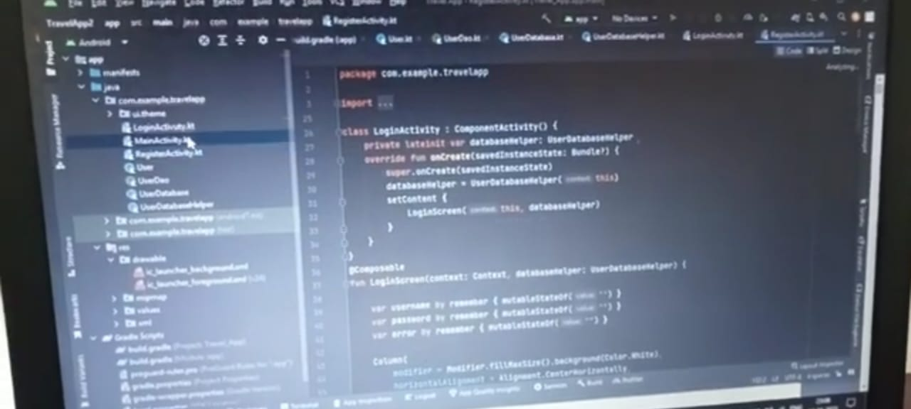

Slide 8
